Slide 1

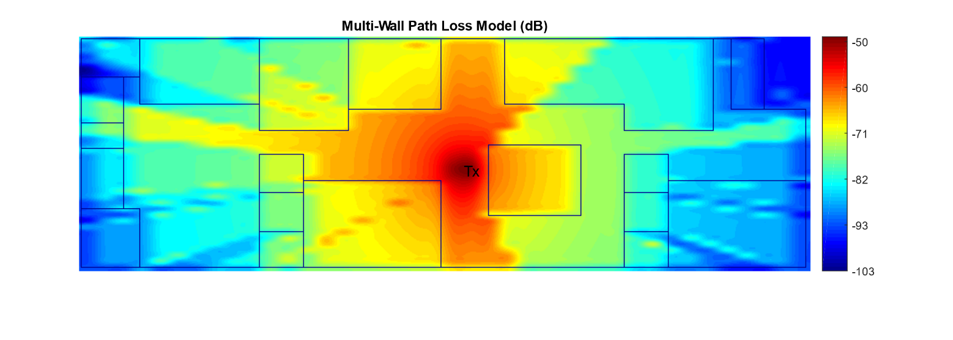
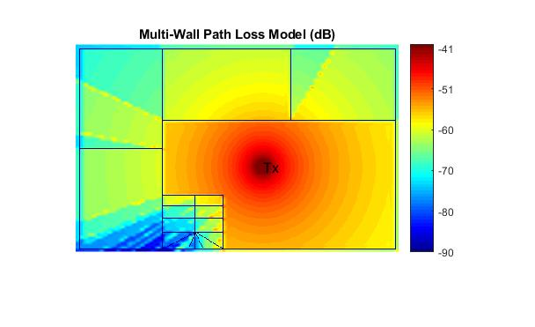
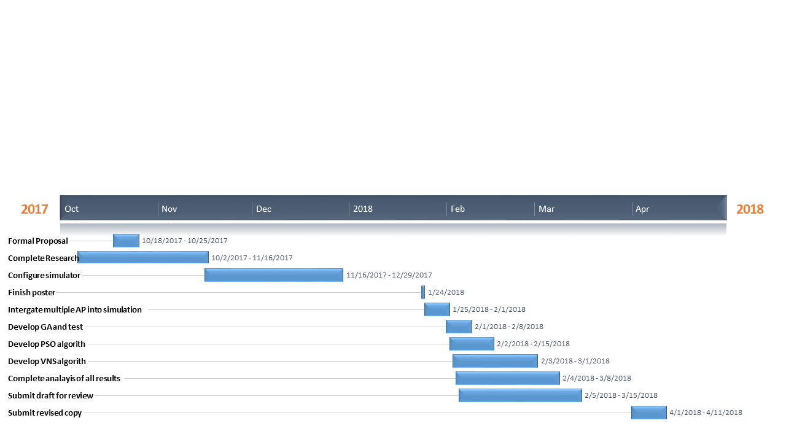
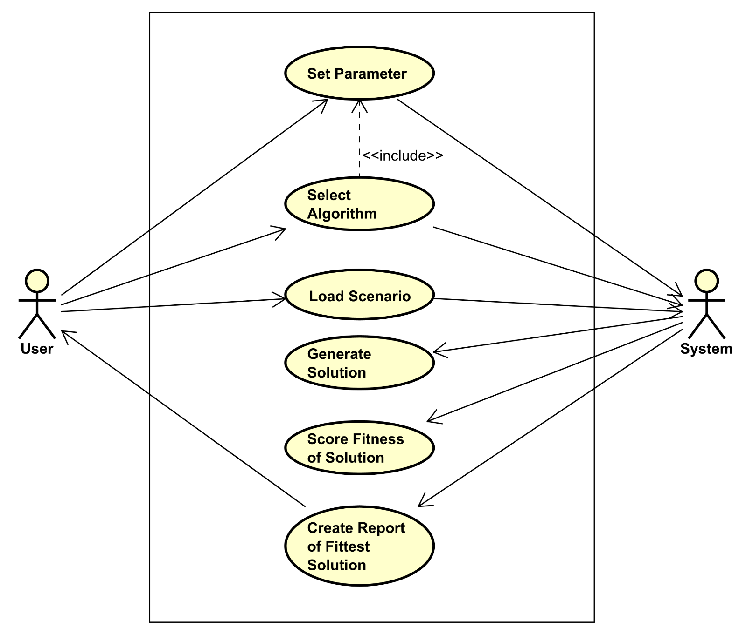
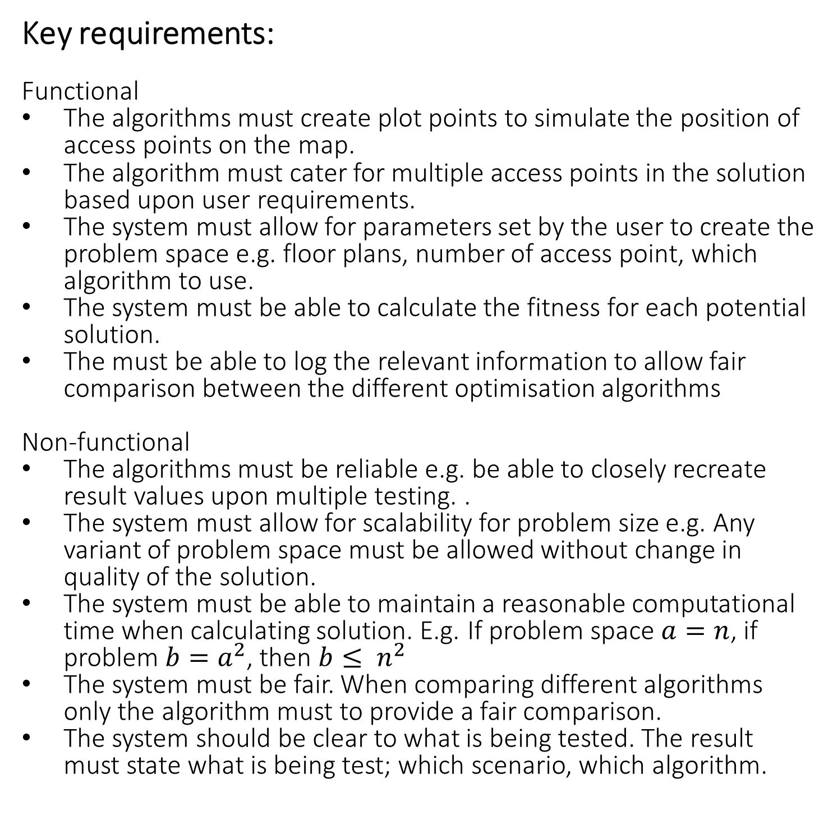
Research: During my research I was able to find a vast array of studies and papers relating to both wireless signal propagation and optimization algorithms. Puspitasari, Fatta & Wibowo (2015) show that the use of greedy and simulated annealing algorithms can both solve the issue but with vast differences in results. By only using those two algorithms its hard to make a fair comparison by only using these two limited themselves. Farsi, Achir, and Boussetta (2014) research shows that while load balancing and channel selection is vital to building a successful wireless network. More information regarding the total amount of people with in the scenario and would need to represent within the simulation. Conclusion of research shows that with the physics behind the radio wave propagation, channel mapping and signal attenuation is vital to the build a successful network, restriction may be needed within the scope of this project.
UFCFXK-30-3: Digital Systems Project
Student name: Simon Llewellyn 04971824
Project Title: Optimisation of Wireless Network Access Point Positioning Using Artificial Intelligence
Abstract:
Designing a wireless network can be a difficult task, many factors must be taken in to consideration such as the size of the area, obstacles, and signal decay/propagation to name a few. The goal of this project is apply various machine learning techniques; particle swarm optimisation (PSO), variable neighbourhood search (VNS), genetic algorithm (GA) against problems spaces designed to simulate floor plans of various sizes. The results will then be compared to discover which algorithm can provide the highest coverage of signal whist using the least amount of access point and computational effort.
Key requirements:
Functional
The algorithms must create plot points to simulate the position of access points on the map.
The algorithm must cater for multiple access points in the solution based upon user requirements.
The system must allow for parameters set by the user to create the problem space e.g. floor plans, number of access point, which algorithm to use.
The system must be able to calculate the fitness for each potential solution.
The must be able to log the relevant information to allow fair comparison between the different optimisation algorithms
Non-functional
The algorithms must be reliable e.g. be able to closely recreate result values upon multiple testing. .
The system must allow for scalability for problem size e.g. Any variant of problem space must be allowed without change in quality of the solution.
The system must be able to maintain a reasonable computational time when calculating solution. E.g. If problem space $a=n$, if problem $b=a^{2}$, then $b≤ n^{2}$
The system must be fair. When comparing different algorithms only the algorithm must to provide a fair comparison.
The system should be clear to what is being tested. The result must state what is being test; which scenario, which algorithm.
Example results : The below heat maps shows the strength of signal across two of the scenario using the state of the simulator.
These result show only a single access point that and using default setting of the simulator created by Salaheddin Hosseinzadeh(2017).
Aims and objectives:
Objectives
Create a problem space with the aid of a simulator that allows the measure the fitness of a solution.
Compile data from previous method and popular algorithms find areas where these algorithms could be improved.
Study other possible optimisation algorithms.
Aims
Create an algorithm that will find the optimal placement for wireless APs within a set area.
Solutions will take into consideration the simulated environment obstacle e.g. walls
Gain the highest signal coverage across the problem space with the minimal amount of AP’s used.
The algorithm should also be able to scale with the same degree of accuracy ideally with minimal trade off in computational time.
Planning and Management:
Design and implementation
Use Case diagram to show the functions that are requires to successfully test each scenario and algorithm.
References: Farsi, A., Achir, N. and Boussetta, K. (2014) WLAN planning: Separate and joint optimization of both access point placement and channel assignment. Annals of Telecommunications - Annales Des Télécommunications. 70 (5), pp.263-274.
Hosseinzadeh, S. (2017) Multi wall (COST231) & Free Space Signal Propagation Models. Available from: https://uk.mathworks.com/matlabcentral/fileexchange/61340-multi-wall--cost231----free-space-signal-propagation-models [Accessed on 04/01/17]
Lin,Y., Yu, W., and Lostanlen, Y. (2012) Optimization of wireless access point placement in realistic urban heterogeneous networks. 2012 IEEE Global Communications Conference (GLOBECOM), Anaheim, CA, USA, 3-7 December 2012, pp. 4963-4968.
Puspitasari, N.F., Fatta, H.A. & Wibowo, F.W. (2015), Implementation of Greedy and Simulated Annealing Algorithms for Wireless Access Point Placement: 3rd International Conference on Artificial Intelligence, Modelling and Simulation (AIMS), Kota Kinabalu, Malaysia, 2-4 December 2015, pp. 165.
This diagram also shows the communication the user has with the system and the order in which each function needs to run.

